Slide 1










ATAI
Advanced Technique of Artificial Intelligence
ATAI
ChongqingUniversity _{AdvancedTechniqueof}
of Technology Artificial Intelligence
Chongqing University of Technology
Chongqing University ^{ATAI}
_{of Technology} Advanced Techniqueof
Artificial Intelligence
Chongqing University of Technology
Chongqing University of Technology
T3Time: Tri-Modal Time Series Forecasting via Adaptive Multi-Head Alignment
and Residual Fusion
code: https://github.com/monaf-chowdhury/T3Time/
—— AAAI ’26
Reported by Junsi Chen
1

Slide 2

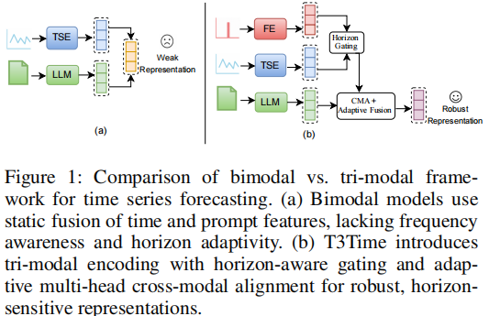
ATAI
AdvancedTechniqueof
Artificial Intelligence
ATAI
ChongqingUniversity _{AdvancedTechniqueof}
of Technology Artificial Intelligence
ChongqingUniversity of Technology
Motivation
(1) Existing models often adopt a modality-isolated architecture, emphasizing a single modality while disregarding the other, which leads to fragmented representations.
(2) If they utilize multi-modalities, they suffer from limited alignment capacity that constrain the model’s ability to capture rich, fine-grained interactions between multi modalities.
(3) These models exhibit horizon rigidity by applying static processing across forecast lengths, ultimately hindering their ability to adapt modality emphasis based on the temporal scope of the prediction.

Slide 3

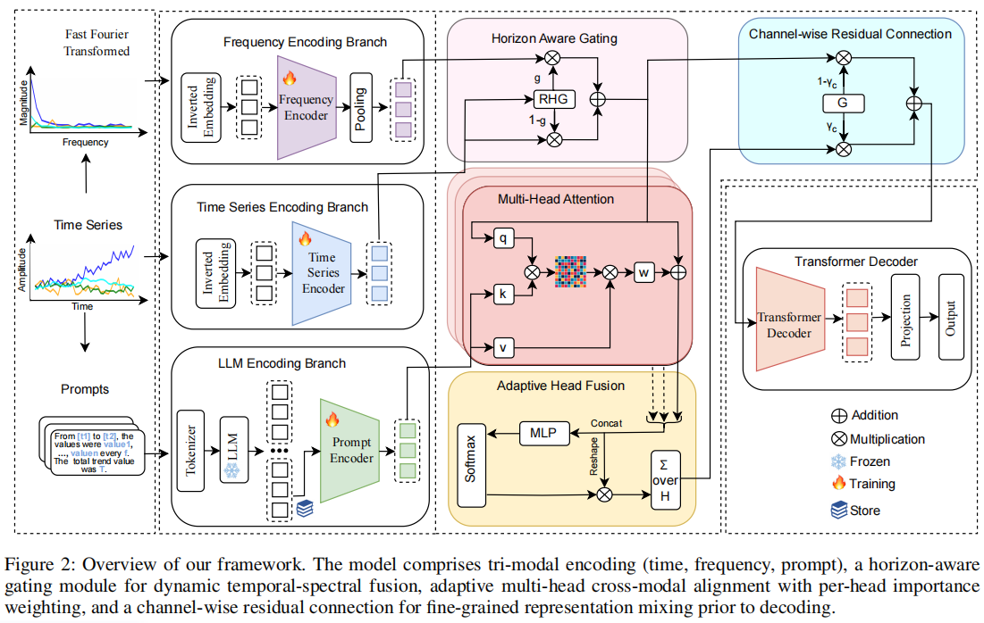
ChongqingUniversity of Technology
ATAI
AdvancedTechniqueof
Artificial Intelligence
ATAI
ChongqingUniversity _{AdvancedTechniqueof}
of Technology Artificial Intelligence
Overview

Slide 4
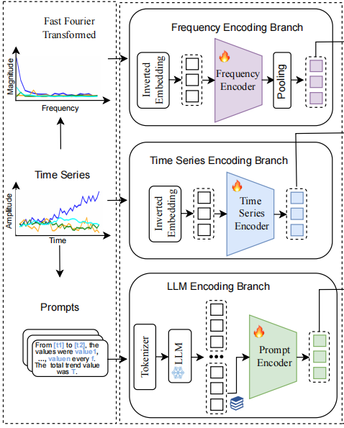



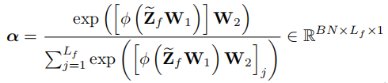





ChongqingUniversity of Technology
ATAI
AdvancedTechniqueof
Artificial Intelligence
ATAI
ChongqingUniversity _{AdvancedTechniqueof}
of Technology Artificial Intelligence
Method
(1)
(2)
(3)
(4)
(5)
(6)
(7)
(8)
(9)

Slide 5
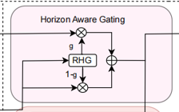


ChongqingUniversity of Technology
ATAI
AdvancedTechniqueof
Artificial Intelligence
ATAI
ChongqingUniversity _{AdvancedTechniqueof}
of Technology Artificial Intelligence
Method
(10)
(11)

Slide 6
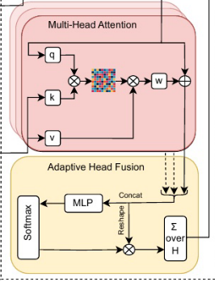




ChongqingUniversity of Technology
ATAI
AdvancedTechniqueof
Artificial Intelligence
ATAI
ChongqingUniversity _{AdvancedTechniqueof}
of Technology Artificial Intelligence
Method
(12)
(13)
(14)
(15)

Slide 7
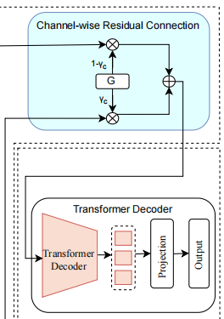


ChongqingUniversity of Technology
ATAI
AdvancedTechniqueof
Artificial Intelligence
ATAI
ChongqingUniversity _{AdvancedTechniqueof}
of Technology Artificial Intelligence
Method
(16)
(17)
(18)

Slide 8

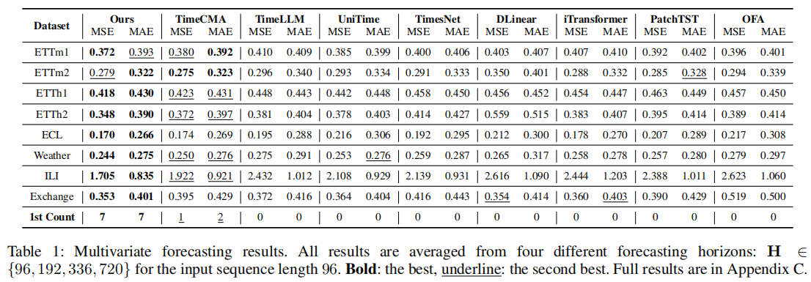
ATAI
Advanced Technique of Artificial Intelligence
ATAI
ChongqingUniversity _{AdvancedTechniqueof}
of Technology Artificial Intelligence
Chongqing University of
Technology
Chongqing University ^{ATAI}
_{of Technology} Advanced Techniqueof
Artificial Intelligence
Chongqing University of Technology
Chongqing University of Technology

Slide 9
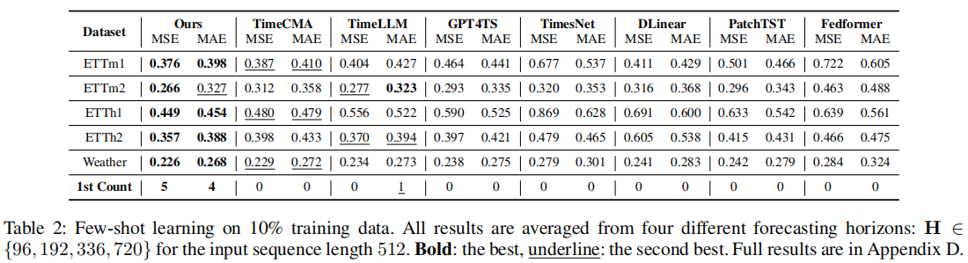
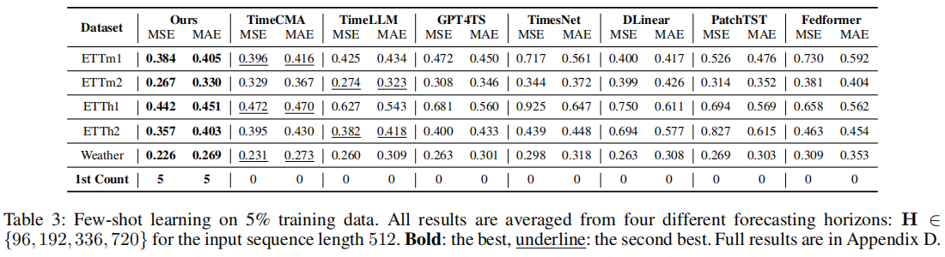
ATAI
Advanced Technique of Artificial Intelligence
ATAI
ChongqingUniversity _{AdvancedTechniqueof}
of Technology Artificial Intelligence
Chongqing University of
Technology
Chongqing University ^{ATAI}
_{of Technology} Advanced Techniqueof
Artificial Intelligence
Chongqing University of Technology
Chongqing University of Technology

Slide 10
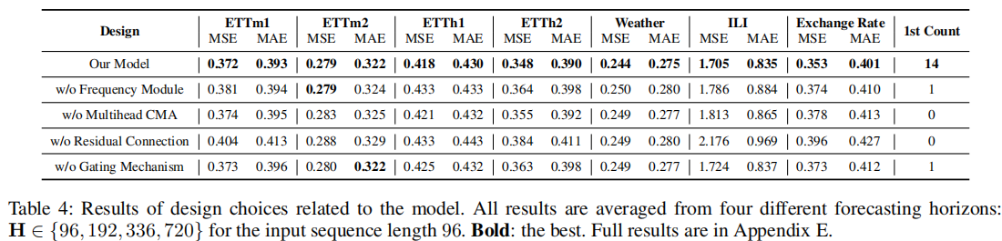
ATAI
Advanced Technique of Artificial Intelligence
ATAI
ChongqingUniversity _{AdvancedTechniqueof}
of Technology Artificial Intelligence
Chongqing University of
Technology
Chongqing University ^{ATAI}
_{of Technology} Advanced Techniqueof
Artificial Intelligence
Chongqing University of Technology
Chongqing University of Technology

Slide 11
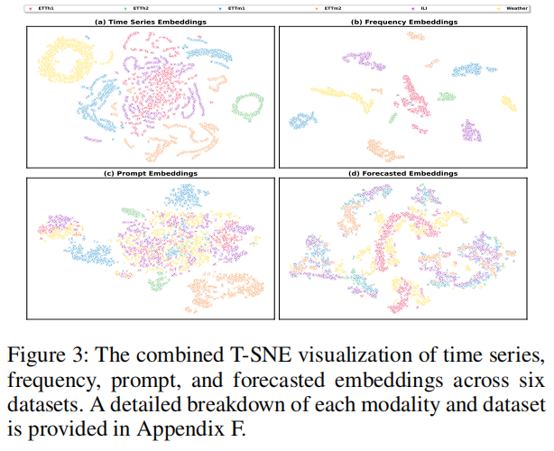
ATAI
Advanced Technique of Artificial Intelligence
ATAI
ChongqingUniversity _{AdvancedTechniqueof}
of Technology Artificial Intelligence
Chongqing University of
Technology
Chongqing University ^{ATAI}
_{of Technology} Advanced Techniqueof
Artificial Intelligence
Chongqing University of Technology
Chongqing University of Technology

Slide 12


ATAI
Advanced Technique of
Artificial Intelligence
ATAI
ChongqingUniversity _{AdvancedTechniqueof}
of Technology Artificial Intelligence
Chongqing University of Technology
Thanks!

